Slide 1

Welcome to
VOTER SENSITIVITY TRAINING!
Please take notes!
You will have a series of questions to answer at the end of this presentation.
A Certificate of Completion will be provided after you successfully complete this course.
Orange County Supervisor of Elections
Notes:
Welcome to training
Please pay attention/stay with us.
Need to work together to get out in 4 hours.
Go over manual, notes section, etc.

Slide 2
Key Points
Locations
Voting
Interaction
Ensure that handicap parking is available and marked. Be prepared to create parking with cones and temporary signs.
Walk the route from parking to the voting room. Is it clear of obstructions, or do you need to mark obstacles with cones.
Entry and exit doors unlocked and accessible.
Have chairs available for voters in line.
Verify that the accessible voting machine (ExpressVote) is turned on and operational.
Locate the headphones and directional pad for the ExpressVote.
Check to make sure you have the card stock for the ExpressVote.
Familiarize yourself with the ExpressVote.
Have the Assisted Voter paperwork ready for completion if necessary.
Identify yourself.​
Try not to make assumptions .
Ask a person before assisting​.
Make accommodations when and where you can​.
Treat people in a manner that is appropriate of their age​.
Be patient and considerate​.
Don’t be afraid to ask questions!

Slide 3
Accessible In-Person Voting
The Help America Vote Act (HAVA) mandates that voters with disabilities be able to mark, cast, and verify their ballots privately and independently using an accessible voting machine.
Florida Statute requires poll workers complete a program on etiquette and sensitivity with respect to voters having a disability, before working during the current election cycle.
Voting equipment, communication methods, and other voting activities must all be accessible to voters with disabilities.
In-person voting is the most widely available voting option; every state and territory is required to conduct in-person voting for federal elections with at least one accessible voting machine per polling place.
The basic accessibility requirement for a polling place is that the pathway into and throughout the building from either public transportation or a parking lot is accessible.

Slide 4
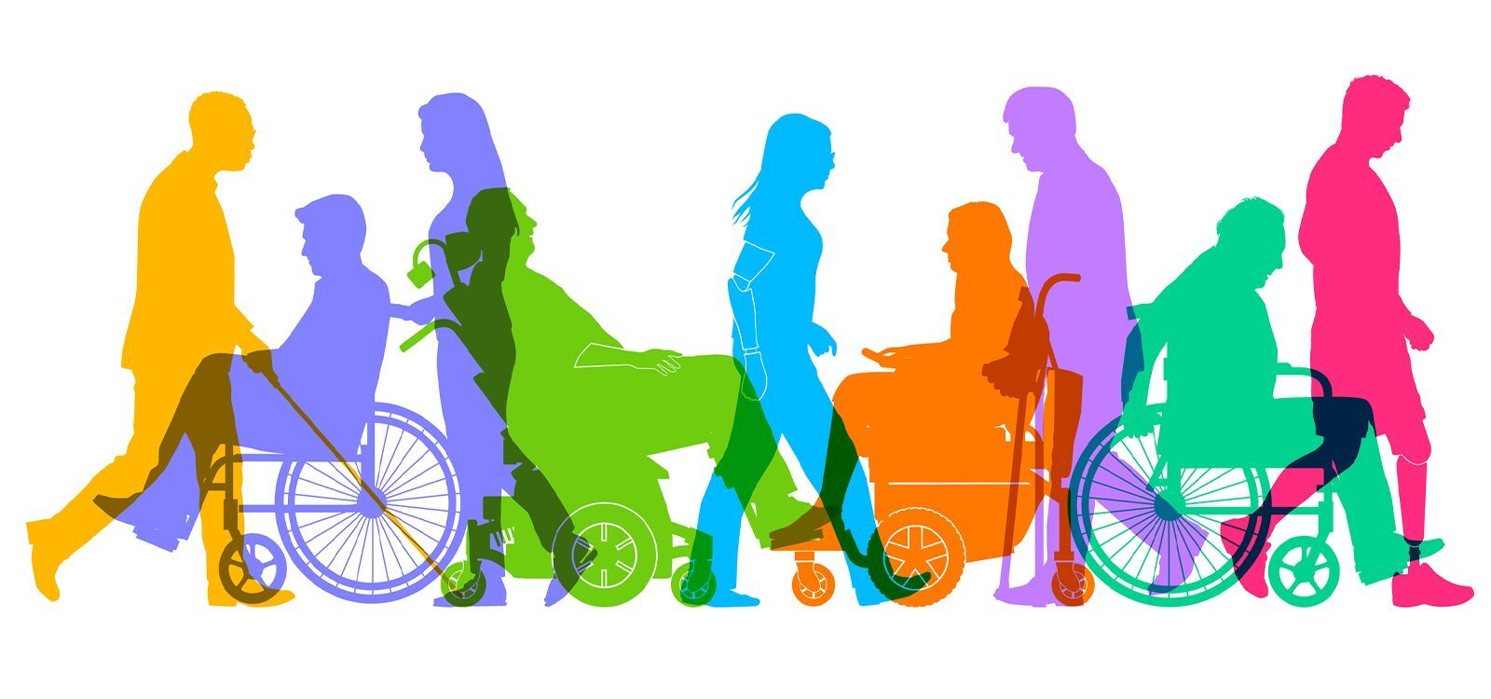
Voters with disabilities represent approximately one-sixth of the American electorate. This growing demographic encompasses a broad range of voters, including those with mobility, visual, communicative, physical, or cognitive impairments. Voters with disabilities face unique obstacles when exercising their right to vote.
The rights of people with disabilities to vote privately and independently with equal access to voter registration and the electoral process is secured through the:
Help America Vote Act of 2002 (HAVA)
Title II of the Americans with Disabilities Act (ADA)
National Voter Registration Act (NVRA)
Voting Accessibility for the Elderly and Handicapped Act
These laws have created a series of rights that ensure voters with disabilities can access all portions of the electoral process in a manner that is accessible to them. Under HAVA, voters with disabilities have the right to be able to mark, cast, and verify their ballot privately and independently.
Title II of the ADA requires state and local governments to ensure that people with disabilities have equal access to government services and information, including the voting process. Additionally, the Voting Accessibility for the Elderly and Handicapped Act requires polling places to be accessible.

Slide 5

Florida Statute
Section 102.014
The Department of State shall develop a mandatory, statewide, and uniform program for training poll workers on issues of etiquette and sensitivity with respect to voters having a disability.
The program must be conducted locally by each supervisor of elections, and each poll worker must complete the program before working during the current election cycle. The supervisor of elections shall contract with a recognized disability-related organization, such as Centers for Independent Living, family network on disabilities, deaf service bureau, or other such organization, to develop and assist with training the trainers in the disability sensitivity programs.

Slide 6

About CIL
The Center for Independent Living in Central Florida, Inc. (CIL) is a private, non-profit organization that was founded in 1976 by Central Floridians dedicated to helping people with disabilities achieve their self-determined goals for independent living. CIL is a consumer-driven organization, that follows a peer-to-peer model whose philosophy is based on peer role models: people with disabilities empowering people with disabilities and their families on the road to independence.
FIVE Core Services:
Information & Referral
Independent Living Skills
Peer Mentoring & Networking
Advocacy
Transition
CIL and the Orange County Supervisor of Elections have been partnering for over 10 years to provide disability sensitivity training to the poll workers of Orange County. People with disabilities are people first and our job is to ensure equal access in all aspects of life. We are the leading local experts on disability advocacy and are happy to share in this training, so you can become and expert too!

Slide 7

Election officials must consider a broad range of accessibility needs to serve their voters, including both visible and invisible disabilities. Many challenges exist, including harnessing a wide range of assistive tools, maximizing available technology, and ensuring voters can vote with confidence. Elections officials can often enhance accessibility with small, practical, and cost-effective adjustments. This training is designed to provide poll workers with recommendations on accessibility considerations and best practices to ensure that all voters can vote privately and independently.
Adhering to federal, state, and local regulations and ensuring accessibility can be a complex process.
Some examples of poll worker responsibilities related to accessibility include:
Assisting voters with the use of accessible voting equipment to ensure that all voters can cast a ballot privately and independently.
Providing assistance to voters based on state and federal legal requirements.

Slide 8
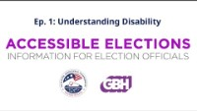
UNDERSTANDING DISABILITY
CLICK BELOW TO BEGIN AN INFORMATIONAL VIDEO

Slide 9
Polling Place Parking Accessibility
Is the parking lot surface accessible?
Is there an accessible drop-off area?
Are there enough accessible parking spaces?
Are there signs for accessible parking spaces?
Is the accessible path to the building entrance free of vehicles?
Is there a clear path from the parking lot to the accessible entrance?

Slide 10
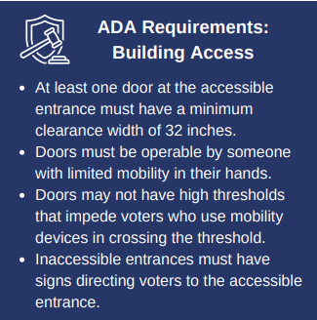
Building Entrance Accessibility
At least one door, doorway, or gate, must be accessible to enter each polling location. This includes exterior entrances and interior spaces that are hosting voting activities.
Is the accessible entrance clearly marked with accessible signage?
Do any inaccessible entrances have signs directing voters to accessible entrances?
Are the entry and exit doors unlocked and propped open?
Are chairs available to voters in line?
Is there an accessible route through the polling place?

Slide 11
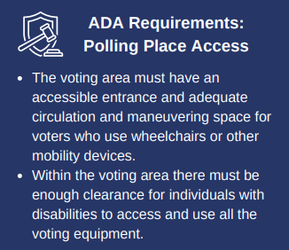

Polling Place Accessibility
Election officials should map the pathway through the polling place to ensure there are no barriers or impediments to accessibility.
Place detectable objects to indicate protruding water fountains, undersides of stairs, or similar barriers. Ensure that these objects (or any other obstacles) do not impede the required maneuvering clearance on both sides of any doors or gates.

Slide 12
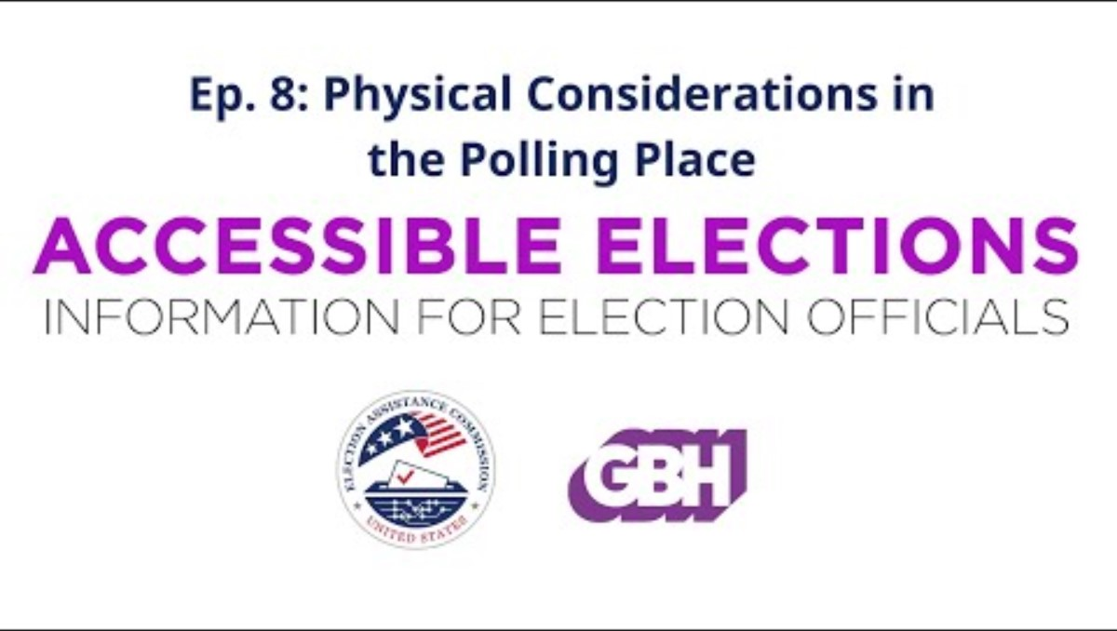
PHYSICAL CONSIDERATIONS FOR THE POLLING PLACE
CLICK BELOW TO BEGIN AN INFORMATIONAL VIDEO

Slide 13
Polling Place Accessibility
Accessibility extends beyond the built environment.
Polling places should include accessible signs and instructions that guide voters through the voting process.
Are check-in signs accessible?
Can the poll workers communicate in an accessible manner?
Are poll workers trained on disability etiquette?

Slide 14
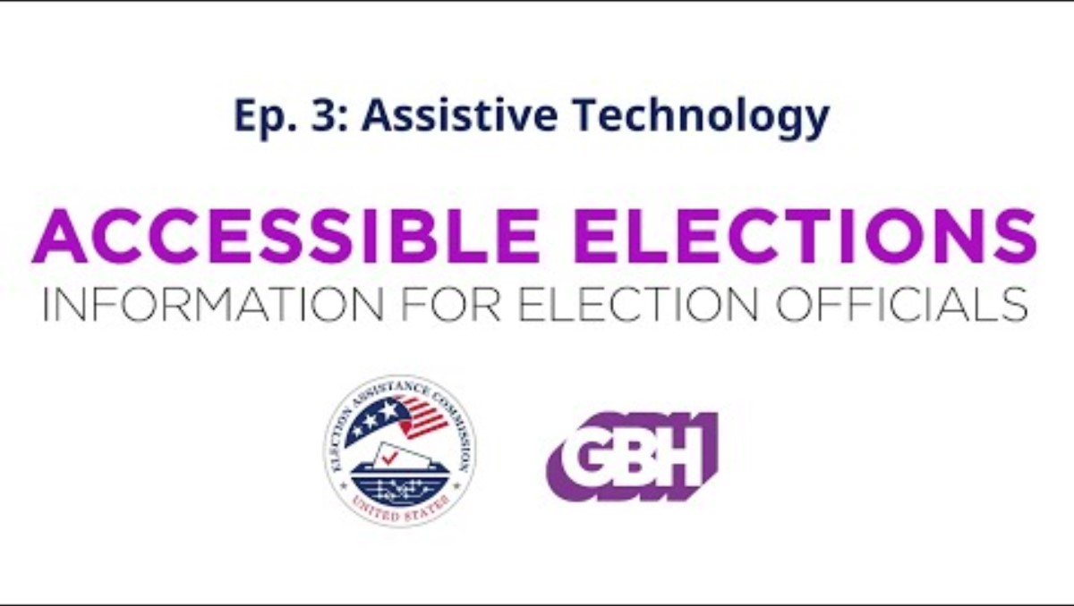
ASSISTIVE TECHNOLOGY
CLICK BELOW TO BEGIN AN INFORMATIONAL VIDEO

Slide 15
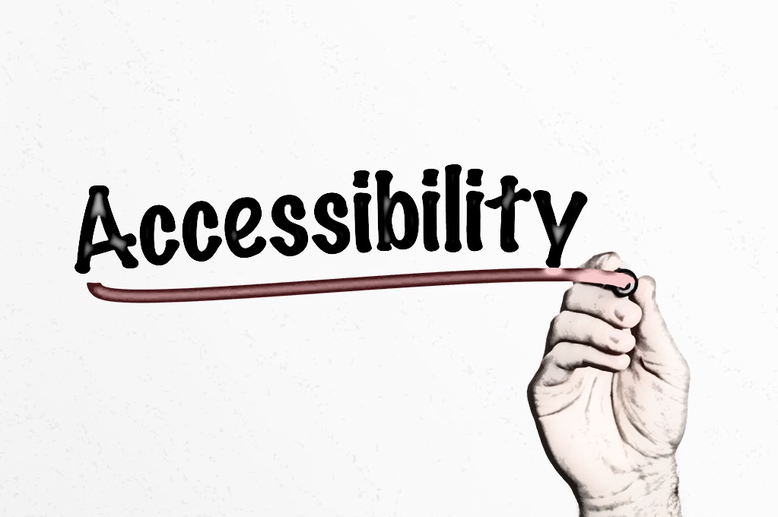

Accessible Voting
Accessible voting is defined as a voter being able to
mark,
cast,
and verify their ballot
privately
and independently.
HAVA requires accessible voting systems for voters with disabilities in all polling places: "The voting system shall... be accessible for individuals with disabilities, including nonvisual accessibility for the blind and visually impaired, in a manner that provides the same opportunity for access and participation (including privacy and independence) as for others."
Voters may choose to use an accessible voting machine, personal assistive technology, or request assistance from a third party to vote subject to the completion of the assisted voter affidavit.
Poll workers should be aware of any available voting aids, voting assistance, or required procedures.
Poll workers should also be trained on how to operate the accessible voting machines and be familiar with the accessible features.

Slide 16
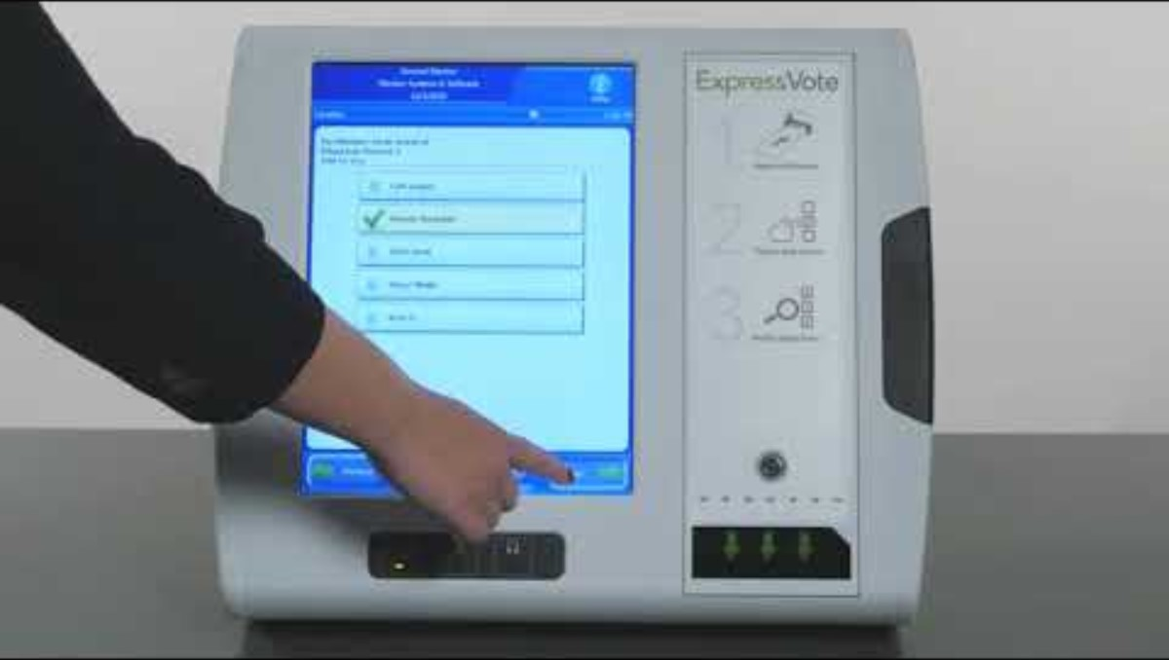
Accessible Voting
Every polling place is required to have at least
one accessible voting machine.
Orange County’s accessible voting machine is the ExpressVote.

Slide 17
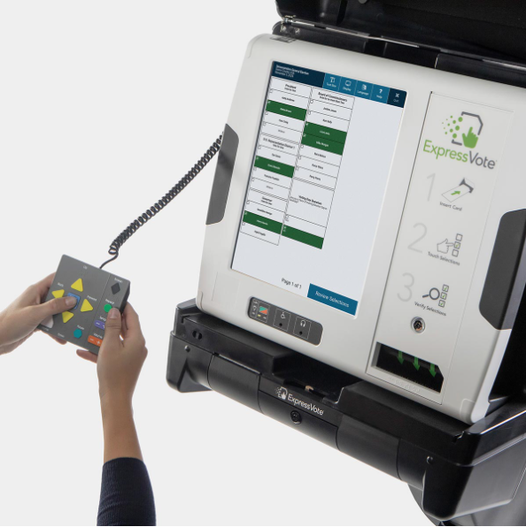
Accessible Voting
It is important that poll workers are familiar with the ExpressVote.
Accessibility features are easy to activate and navigate.
Voters press any key on the audio-tactile keypad to engage the accessibility features. Assistance from a poll worker is not required.
Pressing a button on a rocker paddle or taking a sip/blowing a puff into a sip-and-puff device automatically engages the device and adjusts the navigation accordingly.
Voters can use assistive input devices.
Audio-tactile keypad with Braille legends
Two-position rocker switch
Sip-and-puff device
Voters can connect headphones to listen to the ballot text.
Voters who rely on the audio ballot can black out the screen for privacy.
Voters can adjust the audio volume and tempo
Voters can switch the ExpressVote touch screen to display larger text, high-contrast colors or both.

Slide 18
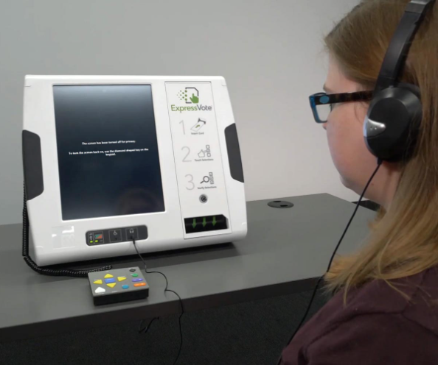
Accessible Voting
Voters who are blind or with a visual impairment can blank the screen and/or use a privacy curtain so they cannot be observed.
Voters can review their selections before and after printing the ballot for verification before tabulation.
Before printing, the voter can review their selections.
After printing, the voter can review selections by re-inserting the printed ballot into the machine. The unit will scan the ballot and read the selections to the voter.
ES&S Universal Voting Systems provide audio read-back of a voter’s selections from the printed ballot without requiring additional hardware.
Screen prompts, symbols, and audio prompts help voters navigate the voting process.

Slide 19
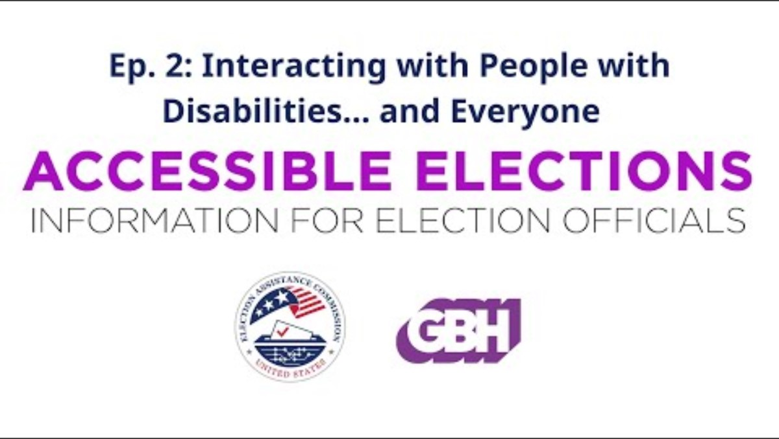
INTERACTING WITH PEOPLE WITH DISABILITIES
CLICK BELOW TO BEGIN AN INFORMATIONAL VIDEO

Slide 20
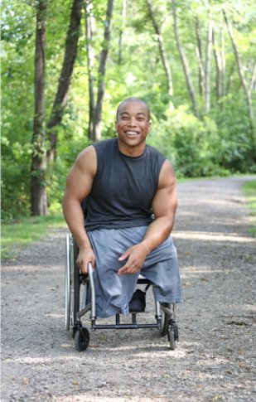

Inclusive and People First Language
People-first language emphasizes the individuality, equality and dignity of people with disabilities. Rather than defining people primarily by their disability, people-first language conveys respect by emphasizing the fact that people with disabilities are first and foremost just that—people.
Place the person before the disability:​
​
Person with a Disability vs. Disabled/Handicapped
Joe is wheelchair bound, or​ Joe is crippled
Joe uses a wheelchair, or ​Joe has a disability

Slide 21


Inclusive and People First Language
YES
NO
Person with an intellectual, cognitive, developmental disability | Retarded Mentally defective
Person who is blind Person who is visually impaired | The blind
Person with a physical disability Person who uses a wheelchair | Crippled Lame Handicapped
Person who is deaf | The deaf Deaf and dumb
Person with cerebral palsy | CP victim

Slide 22

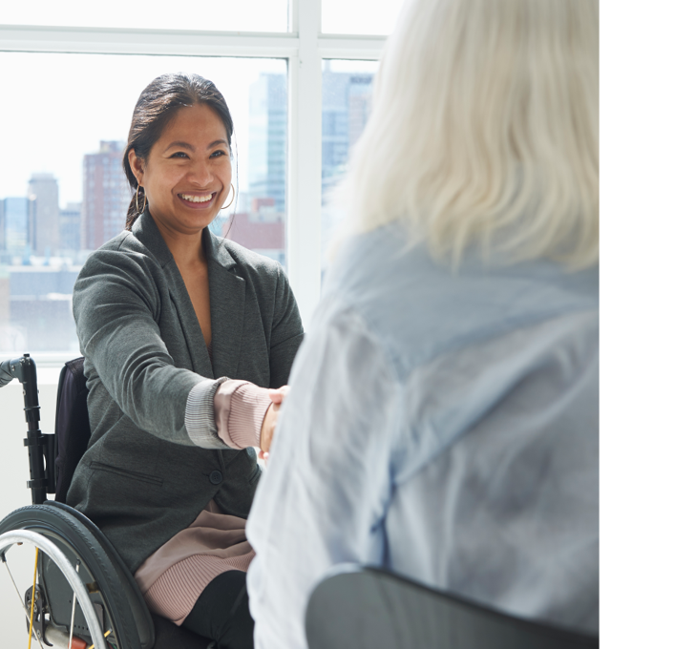
Etiquette & Interaction ​
Tips for People with ​
Specific Disabilities

Slide 23
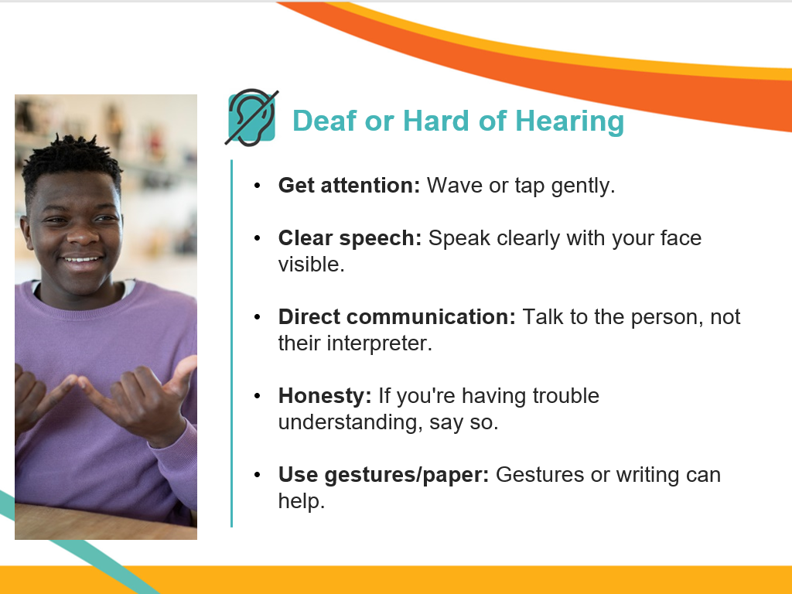

Slide 24
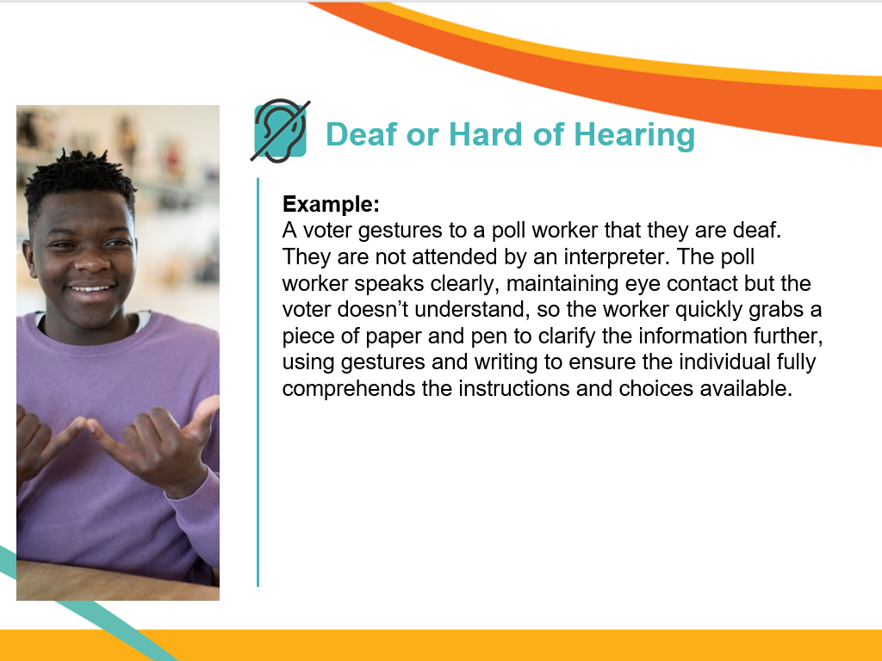

Slide 25
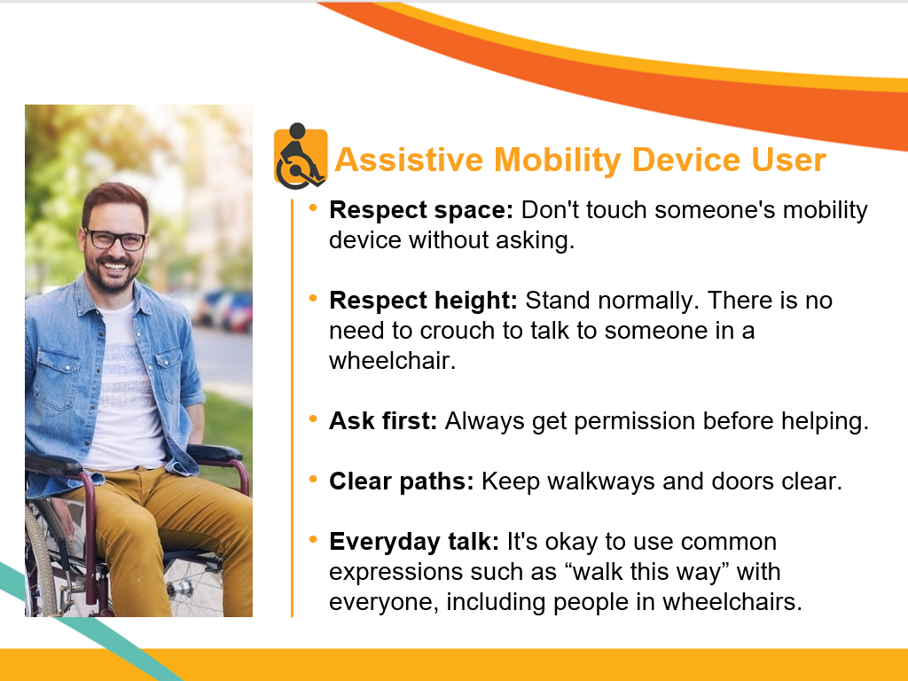

Slide 26
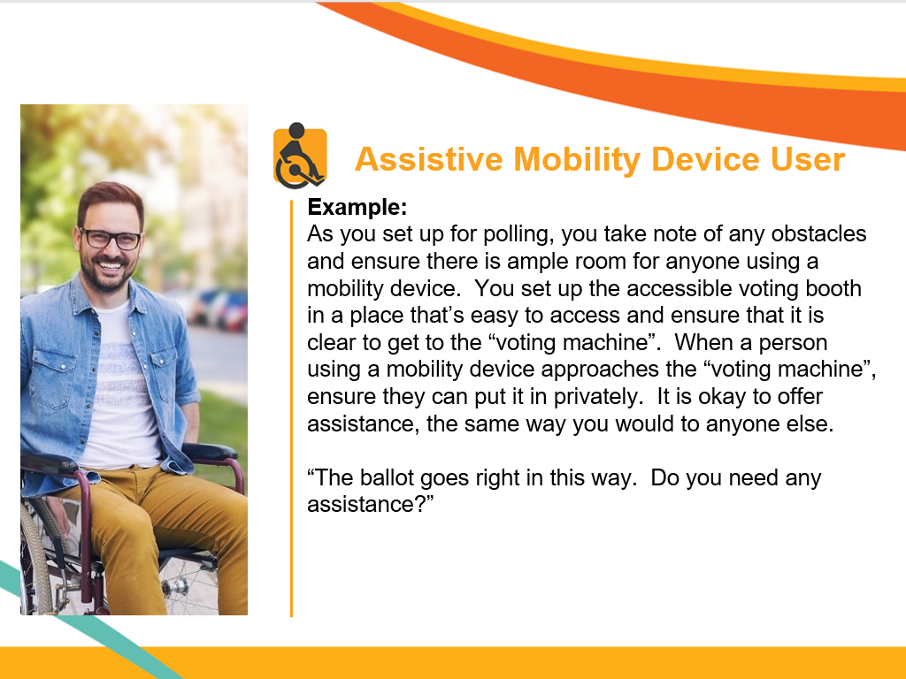

Slide 27
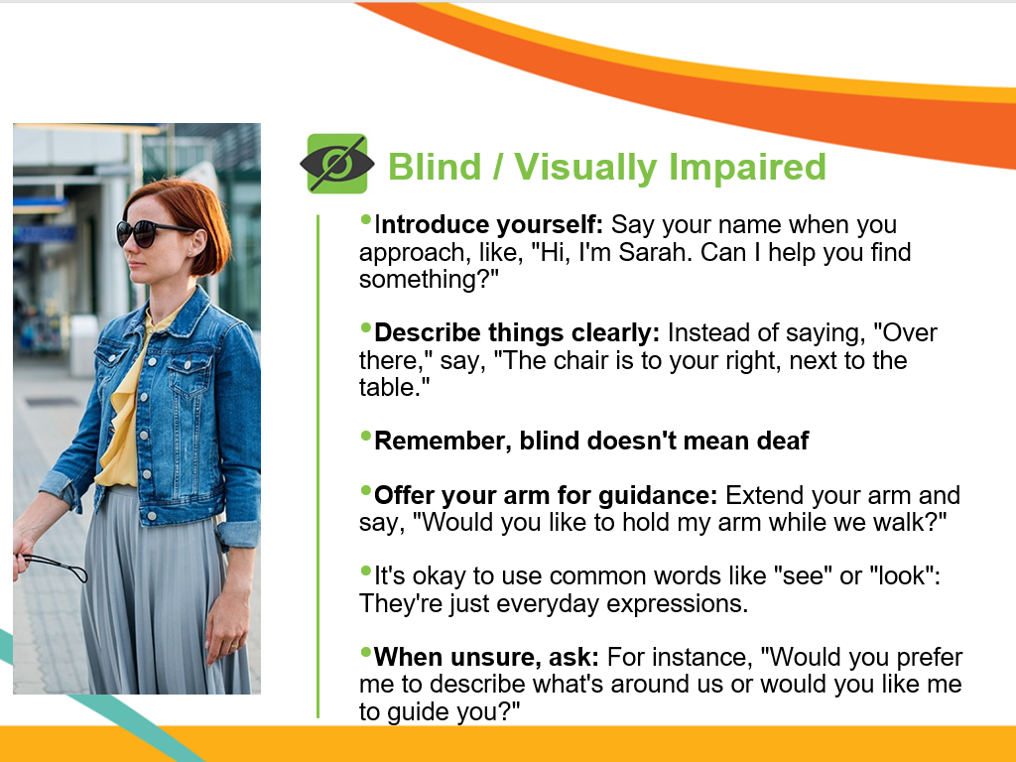

Slide 28
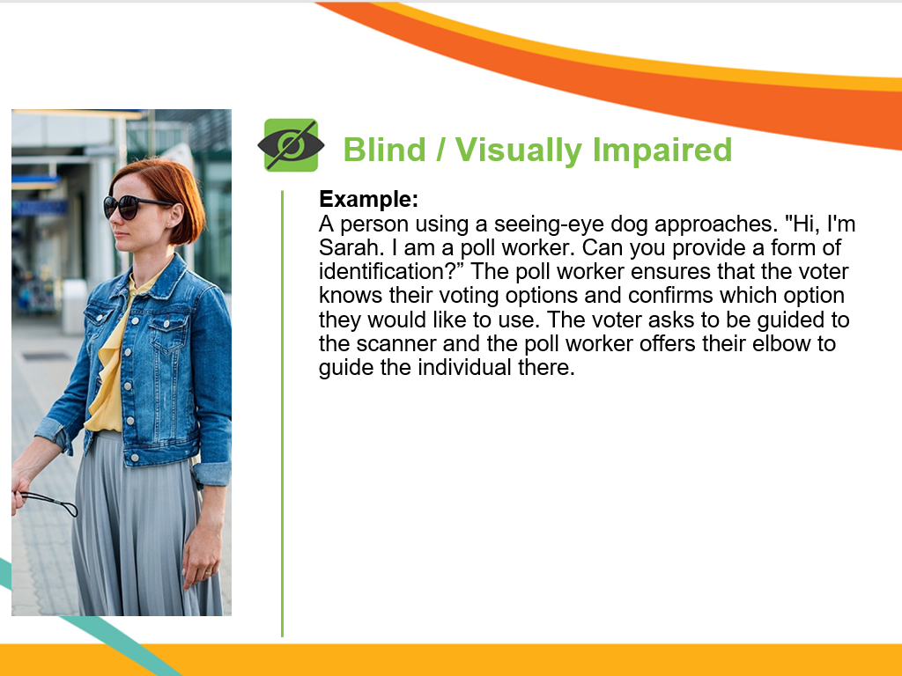

Slide 29
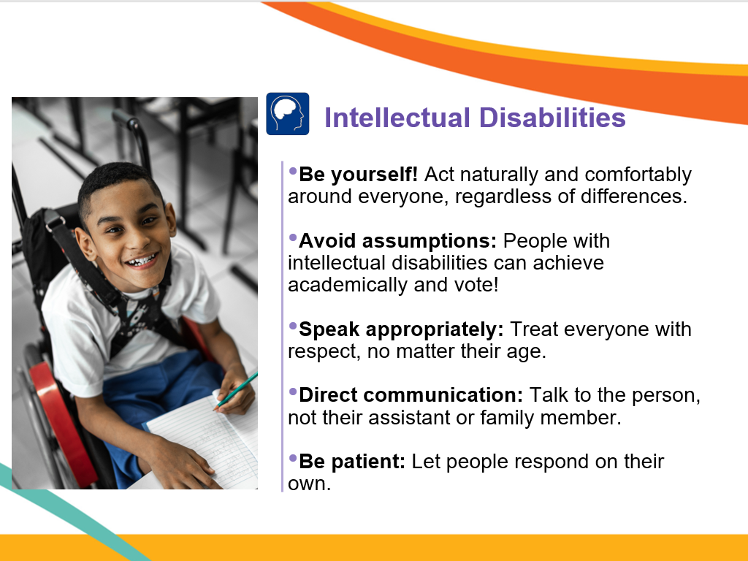

Slide 30
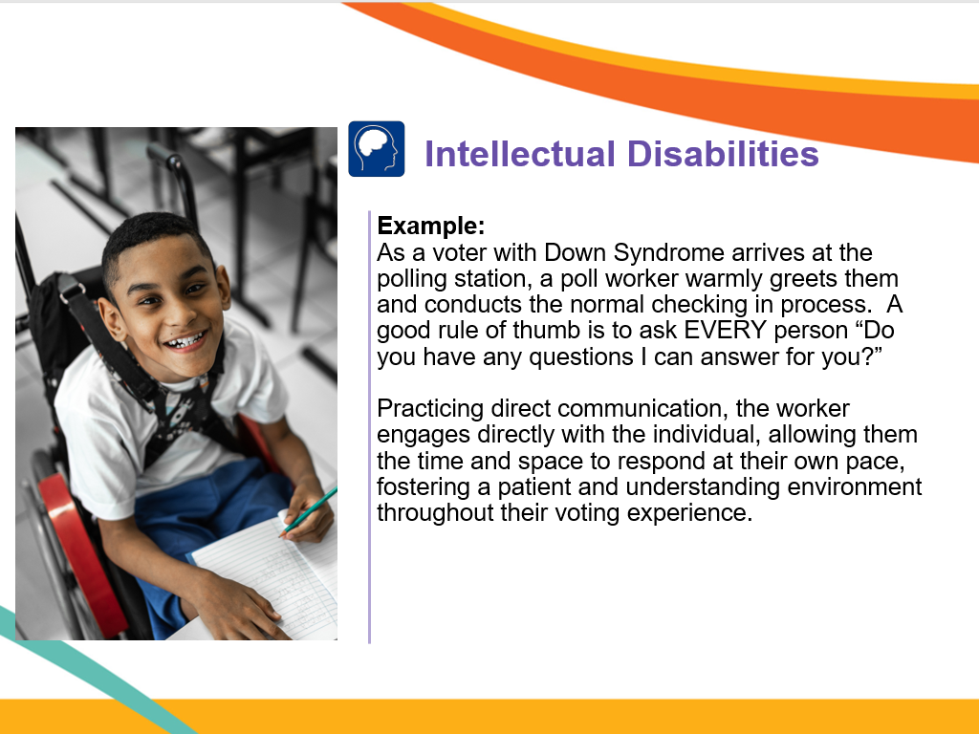

Slide 31
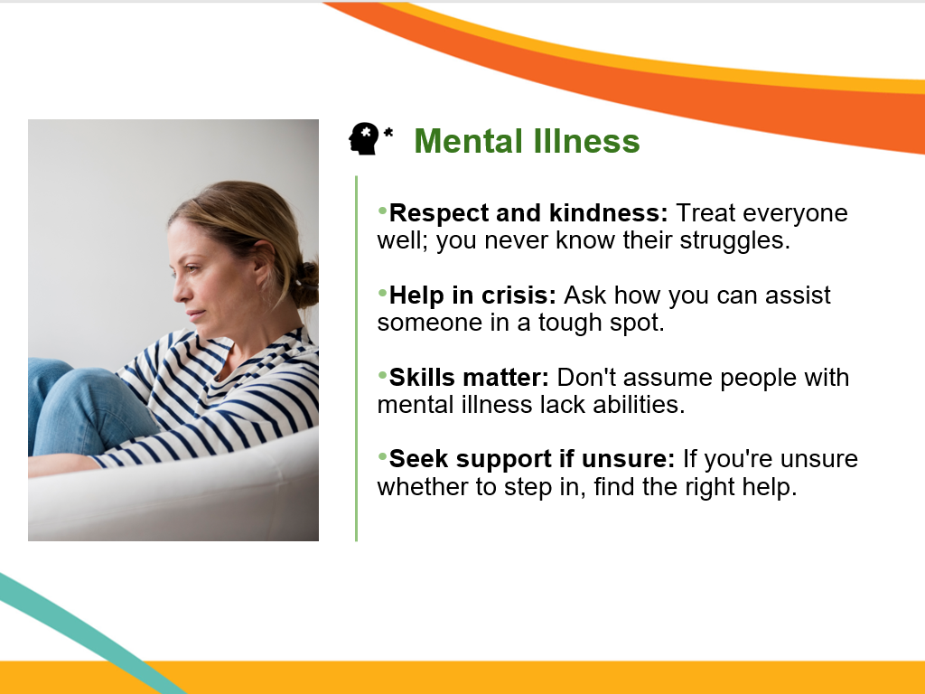

Slide 32
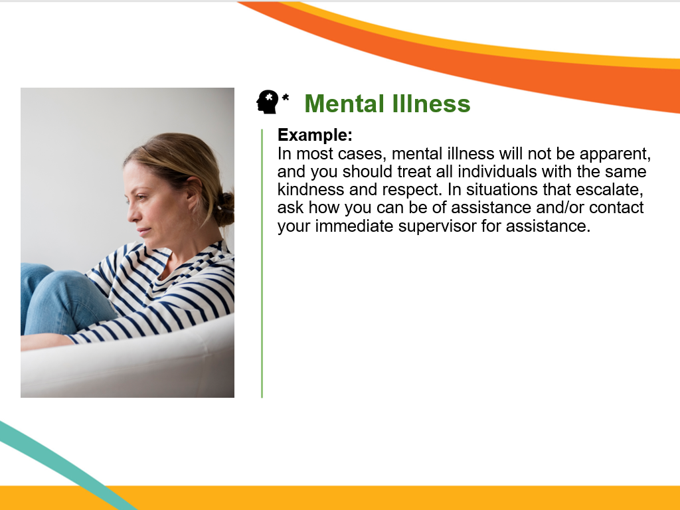

Slide 33
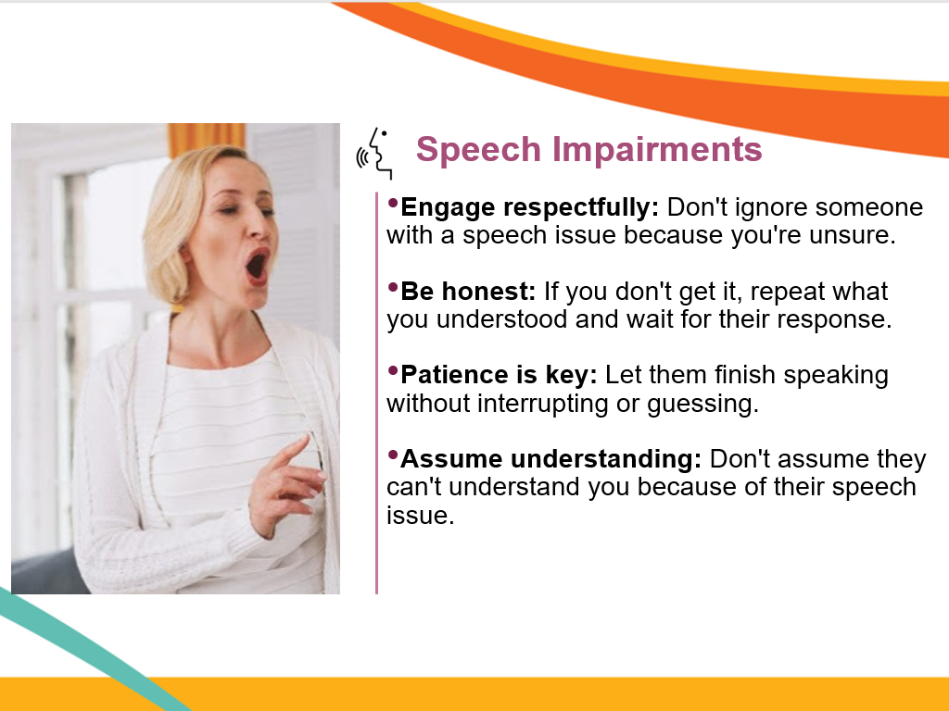

Slide 34
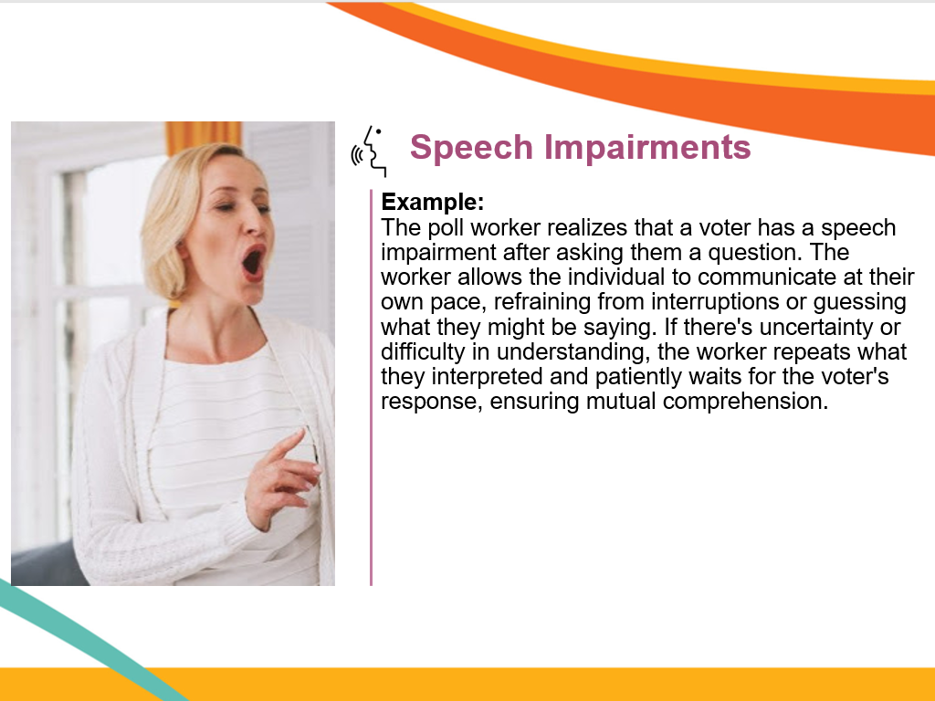

Slide 35
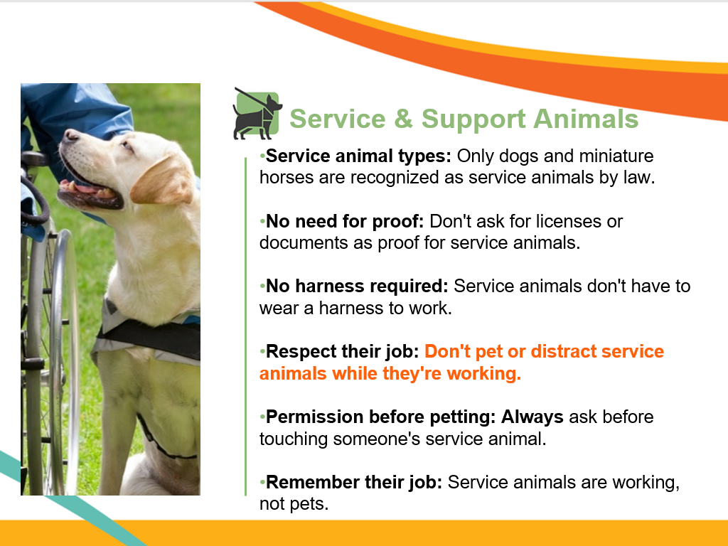

Slide 36
Thank you for your attention!
We appreciate your efforts to ensure all voters in Orange County have the ability to vote!

